Slide 1
Better applying European Criminal Law ERA Court staff training
Mutual Legal Assistance in Criminal Matters

Slide 2
Content:
The concept of Mutual Legal Assistance (MLA)
Relationship between legal instruments for judicial cooperation in criminal matters
Administrative details: transmission channels, forms
Execution of the MLA - Time limits
Special provisions for hearings by videoconference and telephone conference

Slide 3
The concept of Mutual Legal Assistance (MLA)
The main instruments based on the principle of mutual legal assistance include the 1959 Convention and its protocols, supplemented by the Schengen Agreement and the 2000 Convention and its protocol
The mutual assistance instruments and their protocols cover mutual assistance in general but also contain rules on specific forms of mutual assistance such as the interception of telecommunications or the use of videoconferencing
Mechanism based on mutual assistance between the requesting and the requested competent authorities
Grounds for refusal (article 2 of the 1959 Convention) - the request concerns an offence which the requested party considers a political offence, an offence connected with a political offence, or a fiscal offence or if the requested party considers that execution of the request is likely to prejudice the sovereignty, security, ordre public or other essential interests of its country
Double criminality normally requested when executing the LoR
Different provisions on locus regit actum (1959 Convention) and forum regit actum (2000 Convention) regarding the execution of the LoR

Slide 4
Relationship between legal instruments for judicial cooperation in criminal matters
Identify the legal instrument applicable to the two MS involved in the judicial cooperation process
Pay particular attention to the sequence of the legal instruments and their scope of application, as they replace or supplement other legal instruments in relation to MS – e.g. Directive 2014/41/EU regarding EIO is applicable as of 22.05.2017 for all MS with the exception of Denmark and Ireland (related only to taking on evidence)
The relationship with other legal instruments is usually mentioned at the beginning or in the final provisions of the legal instrument in question – e.g. article 34 of the Directive 2014/41/EU regarding the EIO, article 1 of the 2000 Convention
Verify the table of the ratifications for each legal instruments (the legal instrument is only applicable if ratified by the two states involved ). Of course, there are declarations and reservations made….verify them too because they are important to know how the MLA will be executed by the Requested State!!!
The full list of the Conventions (signatures, ratifications, declarations and more) is available on the Treaty office of the CoE’s website -> https://www.coe.int/en/web/conventions/full-list
For the 2000 Convention and its protocol check the EJN website -> https://www.ejn-crimjust.europa.eu/ejn/#

Slide 5
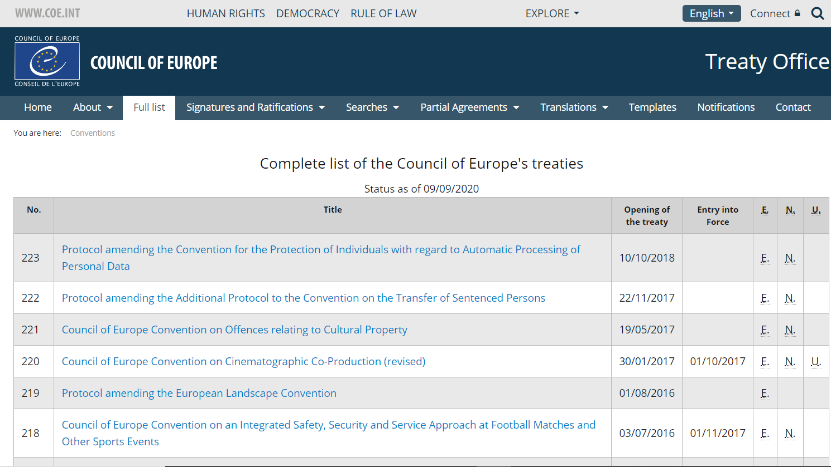
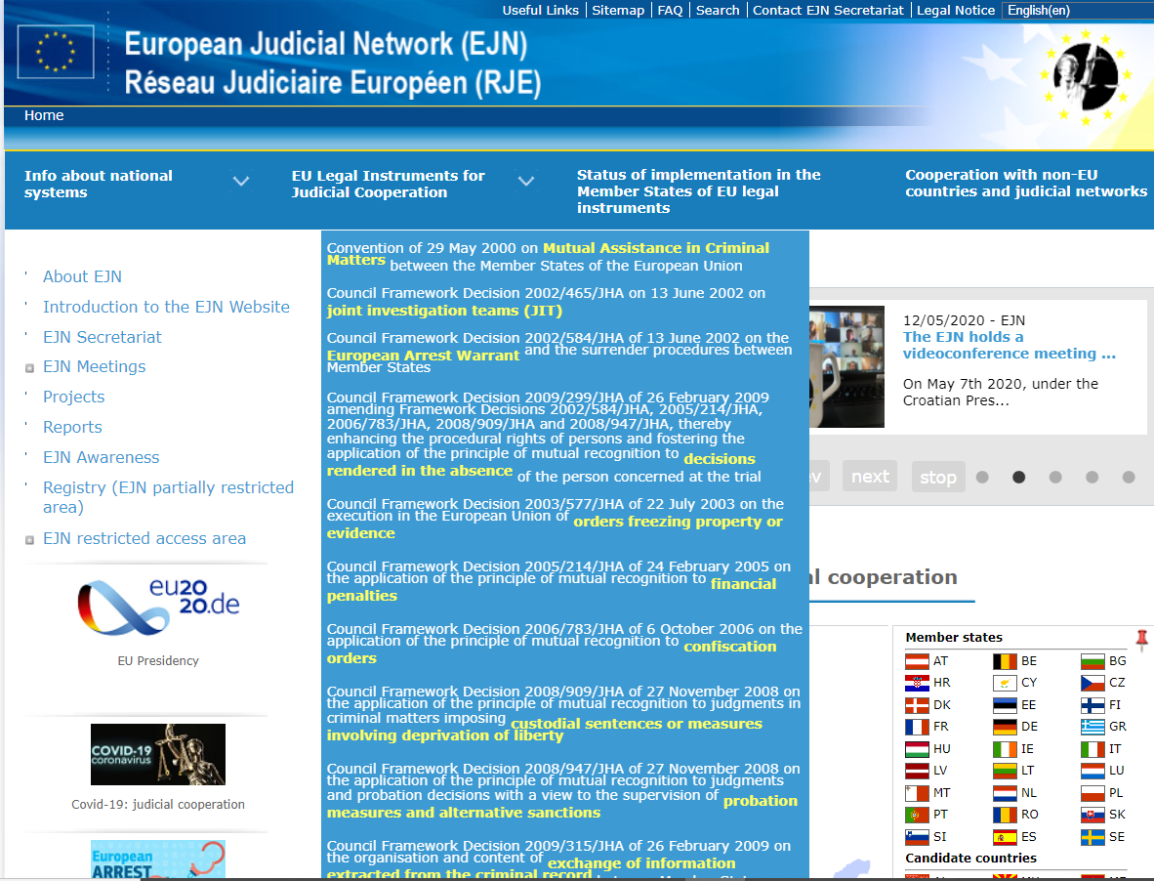
Relationship with other legal instruments for judicial cooperation in criminal matters – cont.

Slide 6
Administrative details: transmission channels, forms
Transmission channels
Requests for mutual legal assistance shall, as a general rule, be transmitted directly between the competent judicial authorities of the Requesting and Requested State (article 6 para. 1 of the 2000 Convention).
Exceptions – e.g. article 6 para. 3 of the 2000 Convention for UK and Ireland (Central Authority)
Article 4 of the Second Additional protocol to the 1959 Convention (MoJ to MoJ) => exception para.2 which allows direct contact between judicial authorities
By any means capable of producing a written record
Forms
No mandatory form to use for cooperation provided in the legal instruments for MLA
Minimum requirements for the content of the request
An LoR form is provided on the EJN website (Compendium) in all EU languages
https://www.ejn-crimjust.europa.eu/ejn/CompendiumChooseCountry/EN

Slide 7
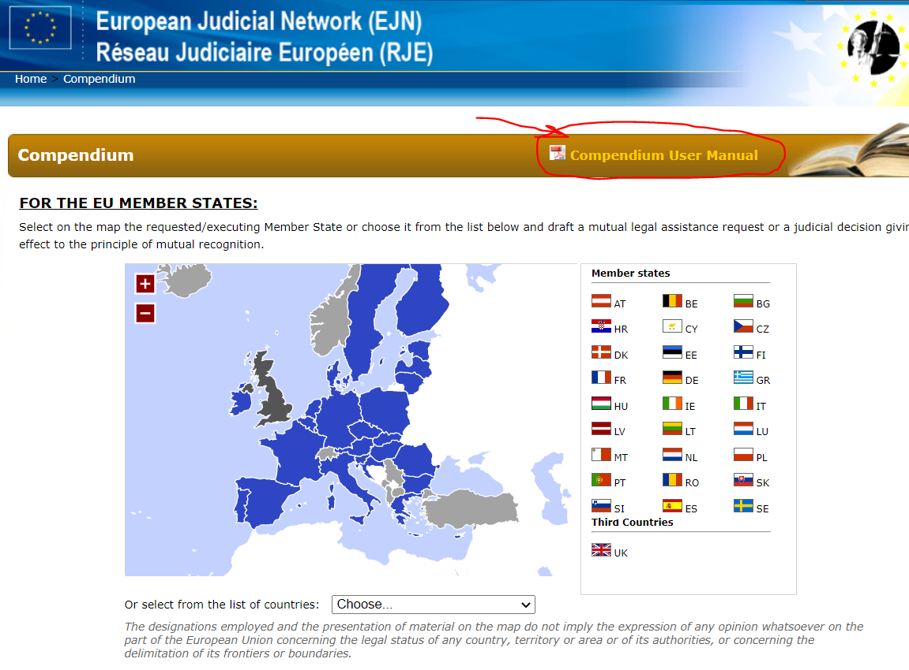
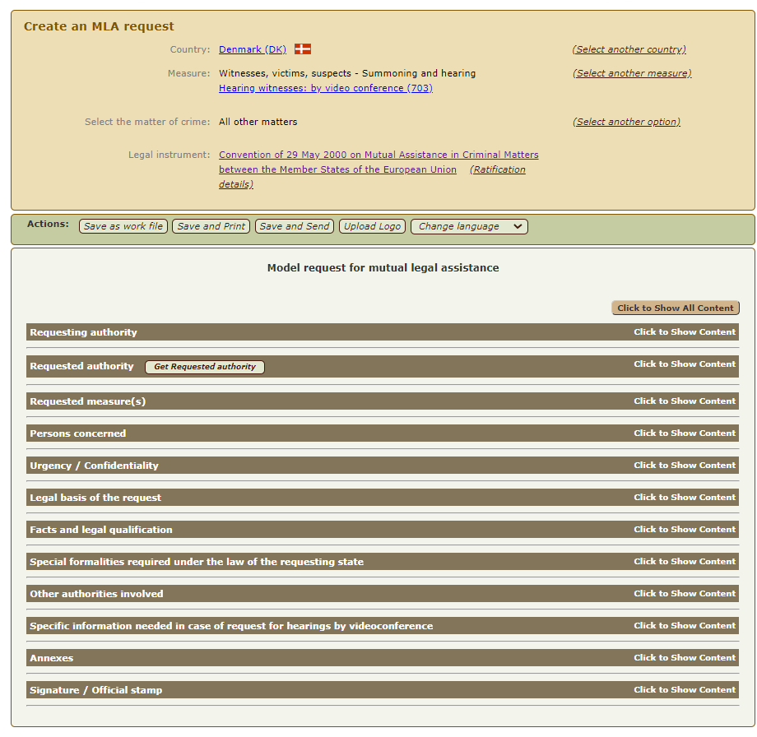
LoR form

Slide 8
Execution of the MLA – Time limits
The requested party shall execute in the manner provided for by its law any letters rogatory relating to a criminal matter and addressed to it by the judicial authorities of the requesting party and to afford each other the widest measure of mutual assistance (articles 1 & 3 of the 1959 Convention) – locus regit actum
The 2000 Convention shifted the balance, and so the authorities of the requested state shall comply with the formalities and procedures indicated by the authorities of the requesting state provided that they are not contrary to fundamental principles of law in the requested state or where the Convention itself expressly states that the execution of requests is governed by the law of the requested Member State (article 4 of the 2000 Convention) – forum regit actum
As a general rule, the requests shall be executed as soon as possible and if possible, within the deadlines indicated by the requesting authority
If it is foreseeable that the deadline set by the requesting state for executing its request cannot be met the authorities of the requested state shall promptly indicate the estimated time needed for execution of the request

Slide 9
Special provisions for hearings by videoconference and telephone conference
Hearing by videoconference => article 9 of the Second Additional Protocol to the European Convention on Mutual Assistance in Criminal Matters (08.11.2001)
Hearing by telephone conference => article 10 of the Second Additional Protocol to the European Convention on Mutual Assistance in Criminal Matters
Hearing by videoconference => article 10 of the 2000 Convention
Hearing by telephone conference => article 11 of the 2000 Convention

Slide 10
Special provisions for hearing by videoconference and telephone conference – cont.
The person is in one Member State’s territory and has to be heard by the judicial authorities of another Member State. It is not desirable or possible for the person to be heard or to appear in the territory of the requesting MS in person
The requested Member State shall agree to the hearing by videoconference provided that the use of the videoconference is not contrary to the fundamental principles of its law
Measures for the protection of the person to be heard shall be agreed, where necessary, between the competent authorities of the requesting and the requested Member States
The hearing shall be conducted directly by, or under the direction of, the judicial authority of the requesting party in accordance with its own laws
The judicial authority of the requested Member State shall draw up minutes indicating the date and place of the hearing, the identity of the person heard, the identities and functions of all other persons in the requested Member State participating in the hearing, any oaths taken and the technical conditions under which the hearing took place, and the document shall be forwarded by the competent authority of the requested Member State to the competent authority of the requesting Member State

